Slide 1

Computer Graphics
Dr. Lucy J. Gudino
Computer Science & Information Systems Group
Birla Institute of Technology & Science, Pilani, Goa Campus
1

Slide 2
Functions of Display Controller
Scan conversion : digitize a picture definition given in an application program into a set of pixel-intensity values
Generating various line styles
Display color areas
Performing certain transformations
Manipulations on display objects

Slide 3
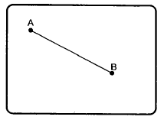
Random-scan Displays
Draws a picture - one line at a time
Random scan systems are also called vector, line drawing, stroke-writing, or calligraphic displays.
The electron beam directly draws the picture in any specified order.
Vectored – electron beam is deflected from end-point to end-point
Information about magnitude and direction is required
Generated with the help of vector graphics generator
Notes:
electron beam directed only to the parts of the screen where a picture is
to be drawn

Slide 4
Random-scan Displays
Picture definition is stored as a set of line-drawing commands ➔ display list or program /refresh display file/ vector file
To display a specified picture, the system cycles through the set of commands in the display file
Order of deflection is dictated by the arbitrary order of the display commands
Phosphor has short persistence
Display must be refreshed by scanning the list at least 30HZ (Max 60 Hz)
More suited for line-drawing applications such as architecture and manufacturing.
Not suitable for realistic pictures with shading

Slide 5
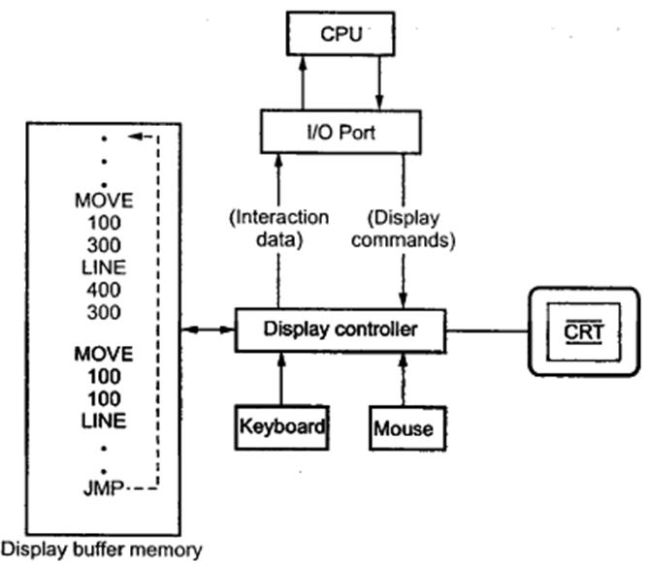
Random Scan Display Architecture
Vector generator: Converts the digital coordinate values to analog voltages for beam deflection

Slide 6
Contd…
Display or Refresh Buffer – memory space allocated to store the display list or display program for the display processor to draw the picture
The display processor interprets the commands in the refresh buffer for plotting
The display processor must cycle through the display list to refresh the phosphor
The display program has commands for point, line, and character plotting

Slide 7
Contd…
The display processor sends digital and point coordinate values to a vector generator
The vector generator converts the digital coordinate values to analog voltages for the beam-deflection circuits
The beam-deflection circuits displace the electron beam for writing on the CRT’s phosphor coating
Minimum refresh rate : 30 Hz. Recommended refresh rate is 40 – 50 Hz.
Scope for animation with segmentation – mixture of static and dynamic parts of a picture

Slide 8

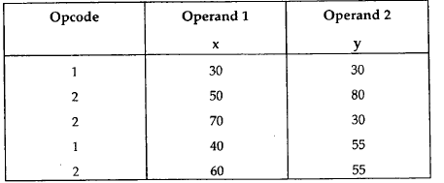
Display Buffer Structure
Stores commands necessary for drawing the line segments
Provides an interface between the image specification process and the image display process and the image display process
Display file command: opcode and operands
Stored in three separate arrays :

Slide 9
Random-scan Displays
Advantages:
High resolution
Easy animation
Requires little memory
Disadvantages:
Requires intelligent electron beam (processor controlled)
Limited to simple, line-based images
Limited color capability.
Improved in the 1960’s by the Direct View Storage Tube (DVST) from Tektronix.

Slide 10
Raster Scan vs. Random Scan
Raster Scan
In raster scan display the beam moves all over the screen - one scan line at a time, from top to bottom and then back to top
The pattern is created by illuminated spots.
produces jagged lines that are potted as discrete point sets.
Random Scan
In vector scan display the beam is moved between the end points of the graphics primitives
Here a picture is drawn one line at a time.
produces smooth line drawings as the CRT beam directly follows the line path.

Slide 11
Raster Scan vs. Random Scan
Raster Scan
The refresh process is independent of the complexity of the image
raster displays have less resolution.
Random Scan
Vector display flickers when the number of primitives in the buffer becomes too large.
random displays have high resolutions since the picture definition is stored as a set of line drawing commands and not as a set of intensity values.

Slide 12
Raster Scan
high degree realism is achieved in picture with the aid of advanced shading and hidden surface technique.
decreasing memory costs have made raster systems popular.
Has an ability to display areas filled with solid colors or patterns
Random Scan
realism is difficult to achieve.
random-scan system's are generally costlier.
Only draws lines and characters

Slide 13
Color CRT Monitor
Color CRT’s are designed as RGB monitors also called full-color system or true-color system.
Two techniques:
Shadow- mask technique: Used in raster scan displays
Beam-penetration technique: used in random scan displays

Slide 14
Shadow Mask
uses three phosphor color dots at each pixel position.
Red, Green and Blue
Uses 3 electron guns and a shadow-mask grid just behind the phosphor-coated screen
Shadow-mask methods with varied intensity from each electron gun (red, green, blue) can produce any color directly on the screen without preprocessing.
Frame buffer contains 24 bits per pixel, for 256 voltage settings to adjust the intensity of each electron beam, thus producing a choice of up to 17 million colors for each pixel.
Full color or true color system

Slide 15
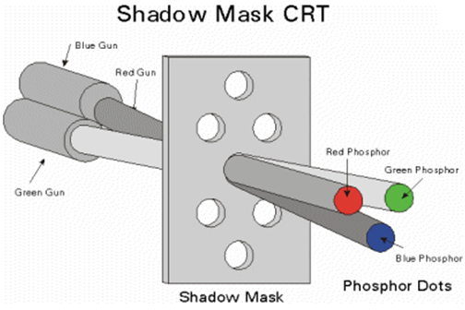
Color CRT Monitor…

Slide 16
Color CRT Monitor- Beam penetration
Beam penetration Technique:
Screen is coated with two layers of Phosphor: red and green
Displayed color depends on how far the electron beam penetrates into the phosphor layers
An inexpensive technique
Can display only four colors: red, green, orange and yellow
Poor quality of pictures produced

Slide 17
Direct-View Storage Tube (DVST)
Main problem with raster scan display
Need to refresh the image
Expensive solution
DVST uses alternate method of maintaining the screen image
Acts as high persistence CRT
Uses a special type of phosphor embedded in a storage tube that has a long lasting glowing effect
Uses storage grid : fine mesh wire grid made of very thin, high quality wire is located with a dielectric
stores the picture information as a charge distribution
Storage grid is placed behind phosphor coated screen
A pattern of positive charges is deposited on the grid and this pattern is transferred to the phosphor coated CRT by a continuous flood of electrons.
Notes:
It is similar to CRT as far as the electronic gun and phosphor coated mechanisms are concerned. But instead of the electron beam directly writing the pictures on the phosphor coated CRT screen, the writing is done with the help of fine-mesh wire grid. The grid made of very thin, high quality wire is located with a dielectric and is mounted just before the screen on the path of the electron beam from the gun. A pattern of positive charges is deposited on the grid and this pattern is transferred to the phosphor coated CRT by a continuous flood of electrons'. This flood of electrons' is produced by a "flood gun" (This is separate frame the electron gun that produces the main electron beam).

Slide 18
Contd…
Consists of two electron guns;
Primary gun
Flood gun
Primary gun: stores the picture pattern
Flood gun: maintains the picture display
Collector: smoothens out the flow of flood electrons

Slide 19
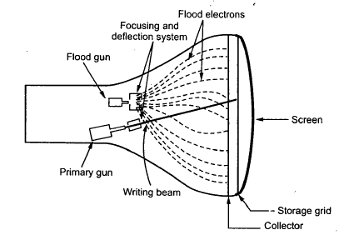
Contd…

Slide 20
Contd…
Advantages:
Refreshing of CRT is not required
Because no refreshing is required, very complex pictures can be displayed at very high resolution without flicker
Disadvantages:
They do not display colours and are available with single level of line intensity
Erasing requires removal of charge on the storage grid. Hence erasing and redrawing process takes several seconds
Selective or part erasing of screen is not possible
Erasing results unpleasant flash over the screen
Not suitable for dynamic graphics applications

Slide 21
Reading Assignment
Flat Panel displays
Plasma
LCD monitor

